Slide 1
Photomicrographs of Plant foods
Grape: Green & Red
Permission to reproduce original photomicrographs used to make this collection may be obtained from
Dr. David O. Norris at
david.norris@colorado.edu

Slide 2
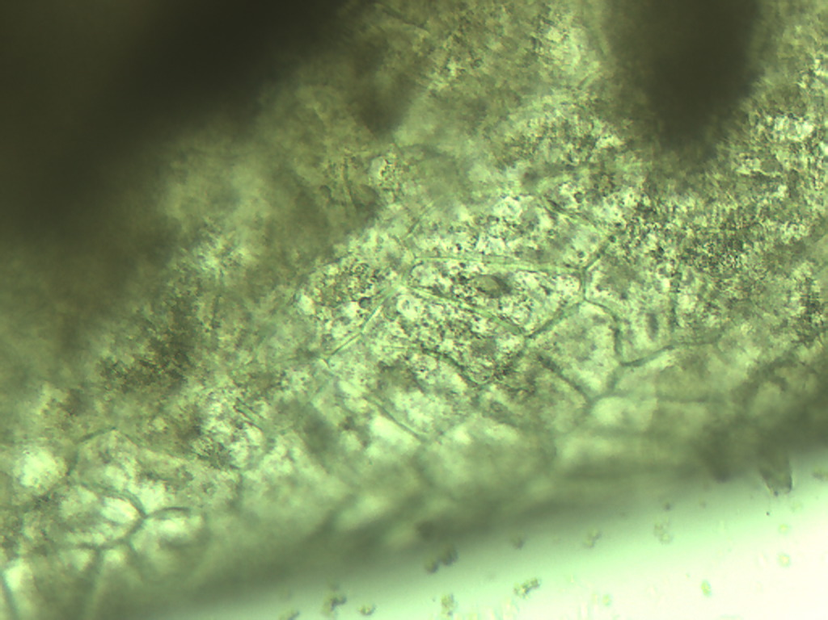
Notes:
223. Vitus spp. L. Grape, green. Skin epidermal cells, 25X

Slide 3
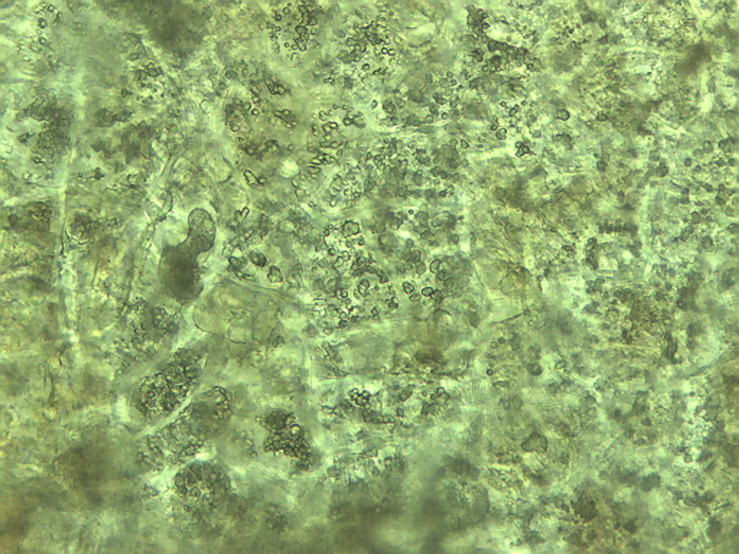
Notes:
224. Grape. Skin epidermal cells, 25X

Slide 4
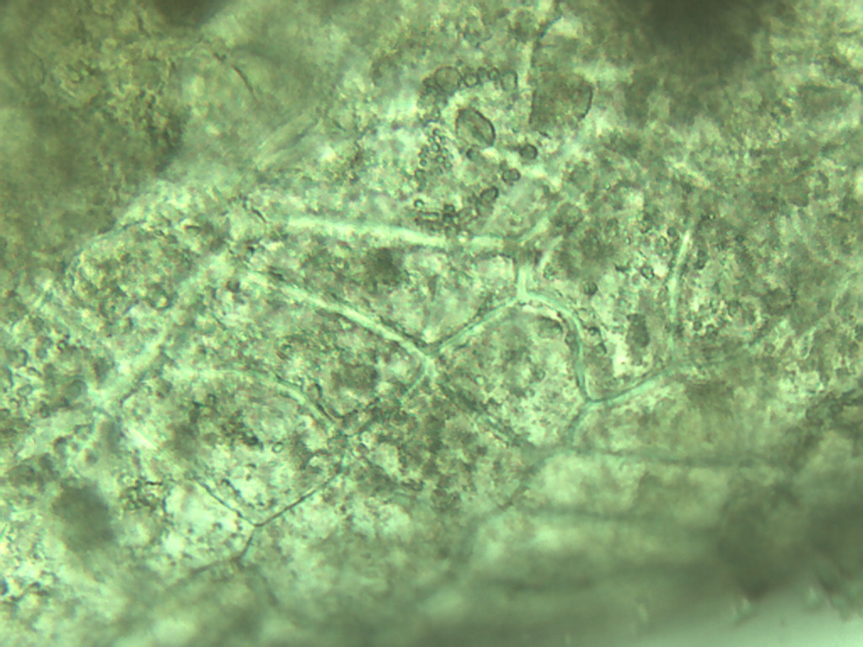
Notes:
225. Grape, green. Skin epidermal cells, 40X

Slide 5
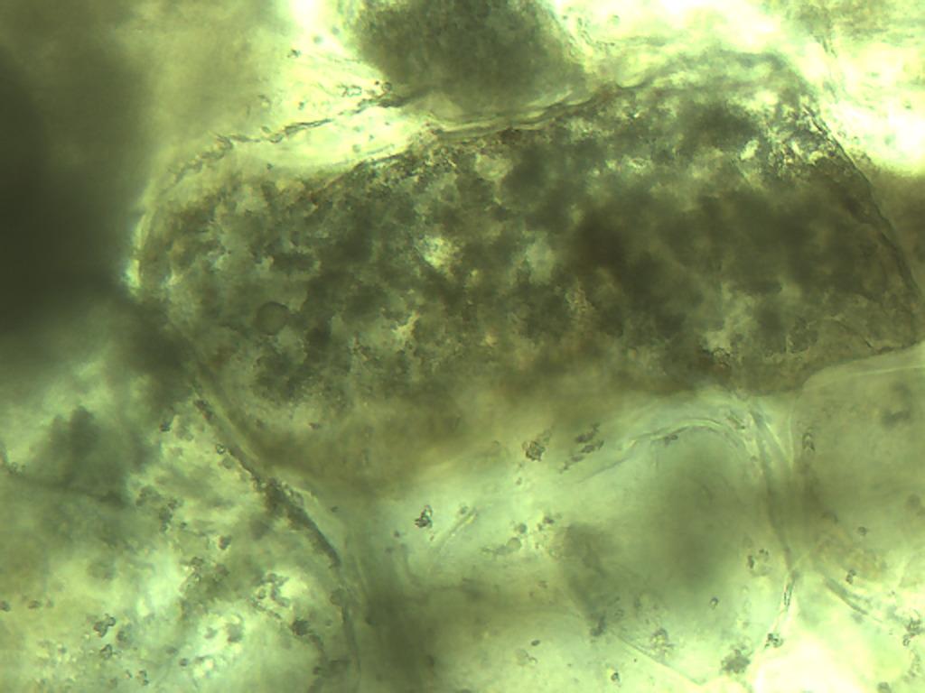
Notes:
226. Grape, green. Skin, epidermal cells, 25X

Slide 6
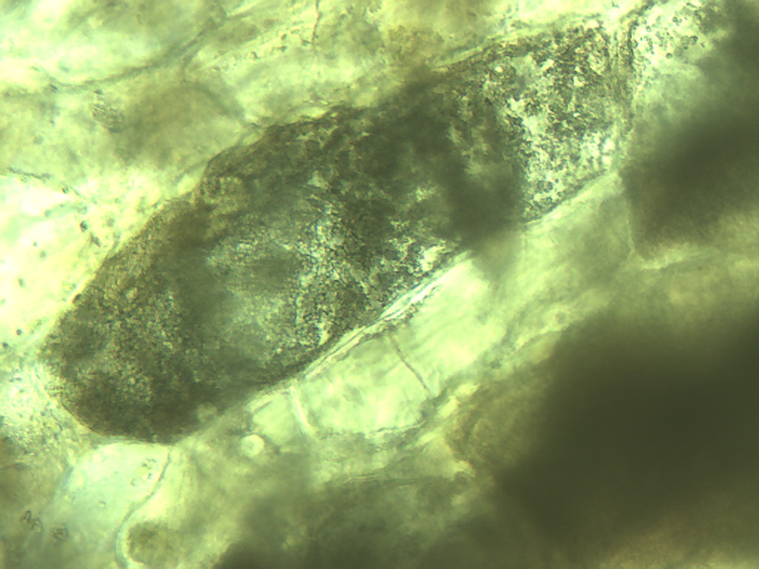
Notes:
227. Grape, green. Skin epidermal cells, 25X

Slide 7
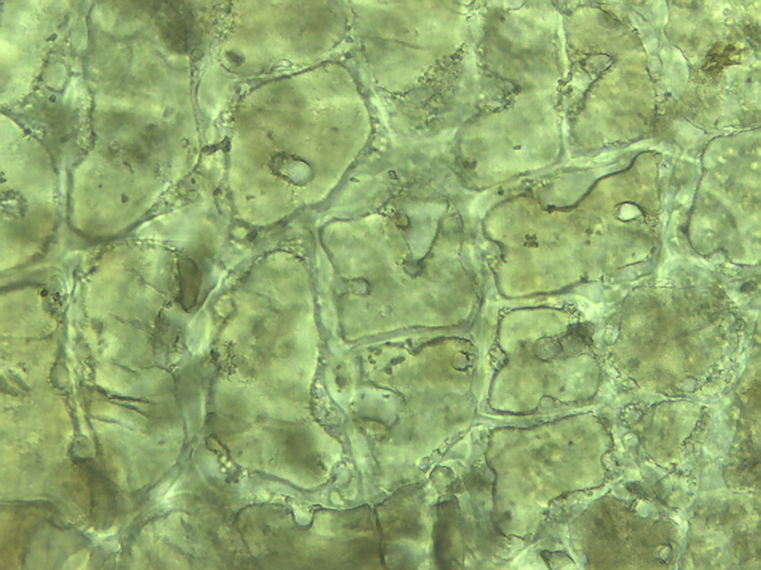
Notes:
228. Grape, green. Skin epidermal cells, 25X

Slide 8
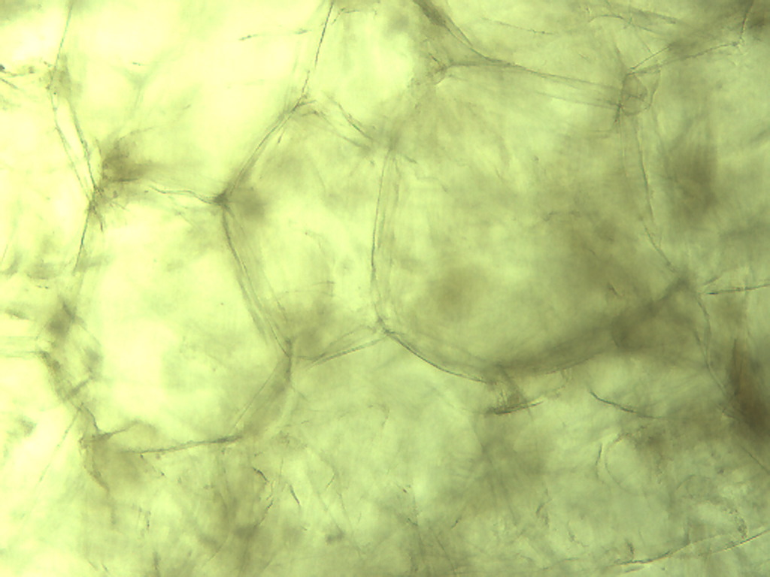
A
Notes:
229. Grape, green. Parenchymal cells, 10X. See 25X of A on next slide.

Slide 9
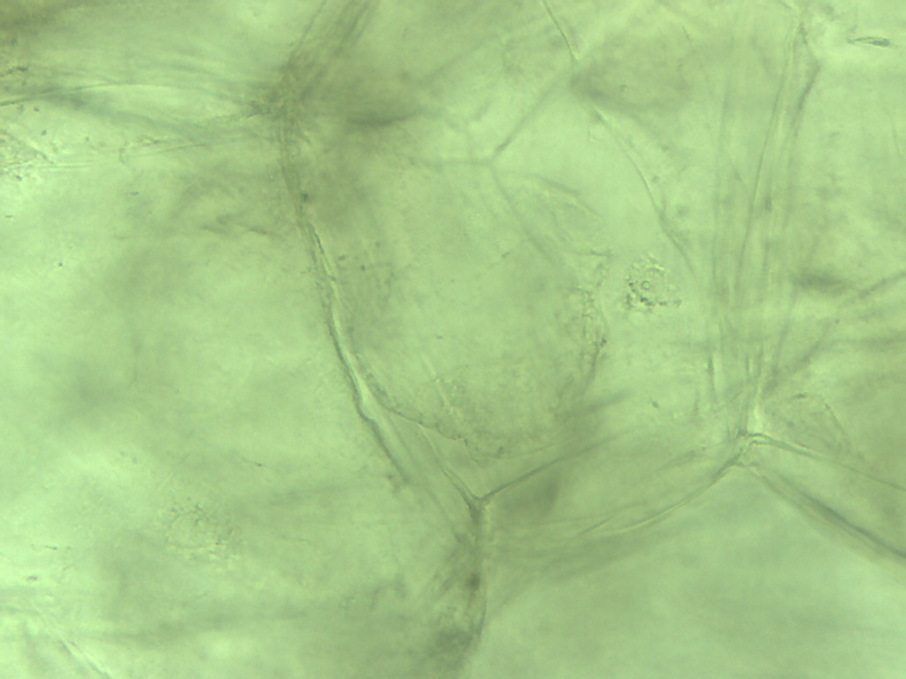
Notes:
230. Grape, green. Parenchymal cell, A at 25X.

Slide 10
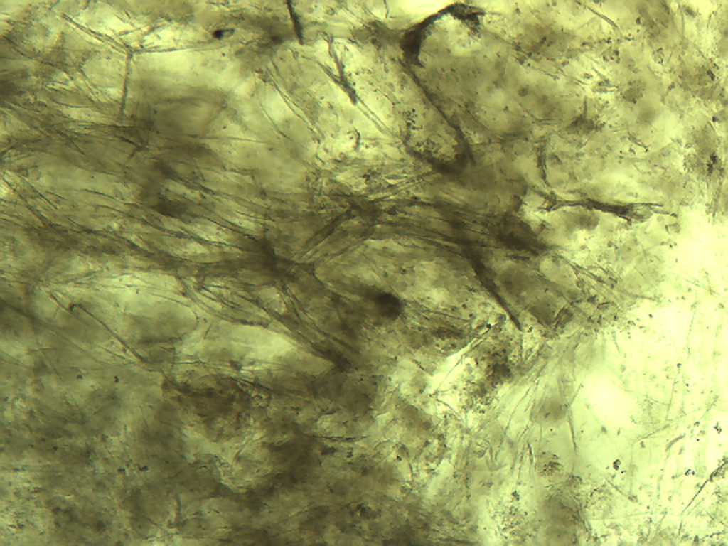
Notes:
231. Grape, green. Pulp cells. 10X

Slide 11
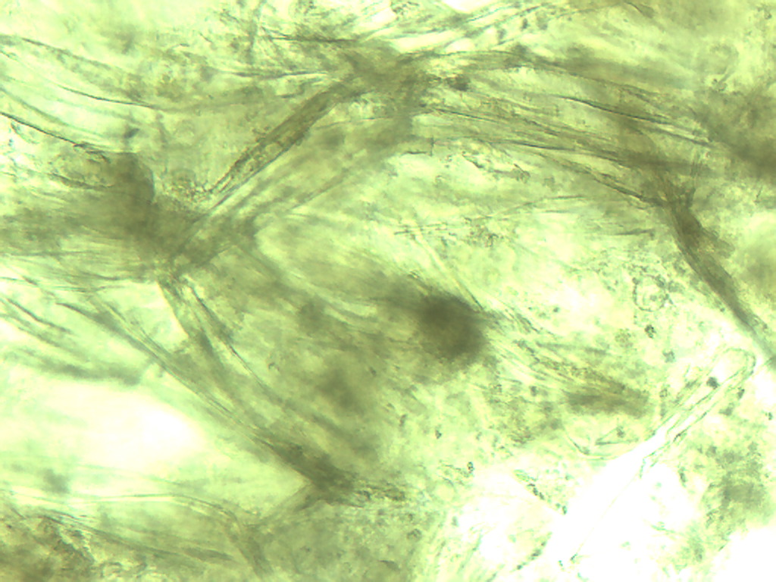
Notes:
232. Grape, green. Pulp 25X

Slide 12
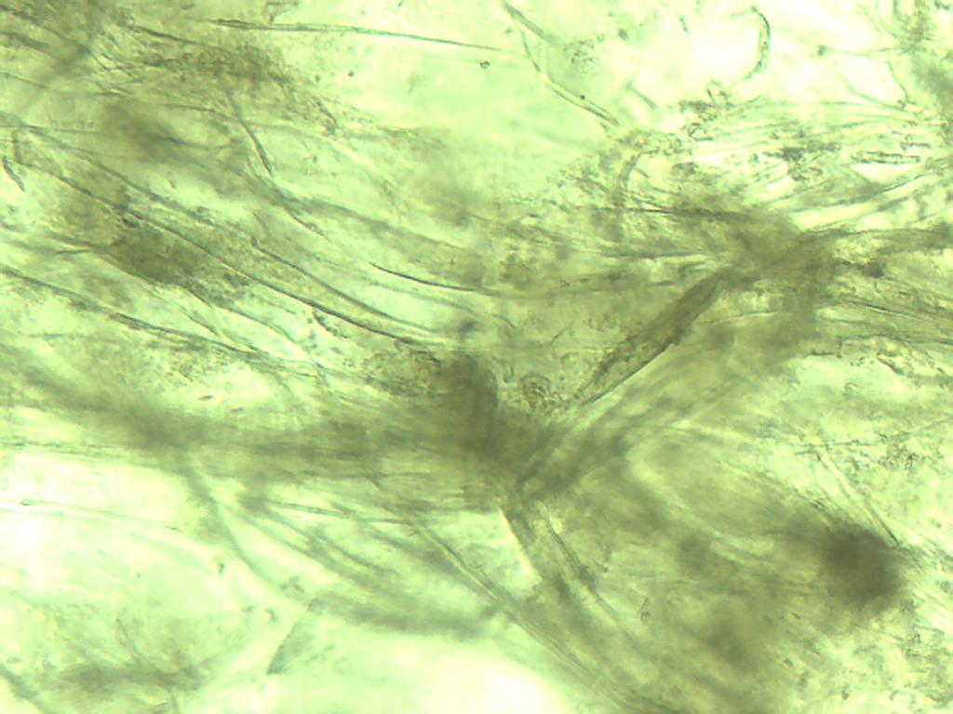
Notes:
233. Grape, green. Pulp, 25X.

Slide 13
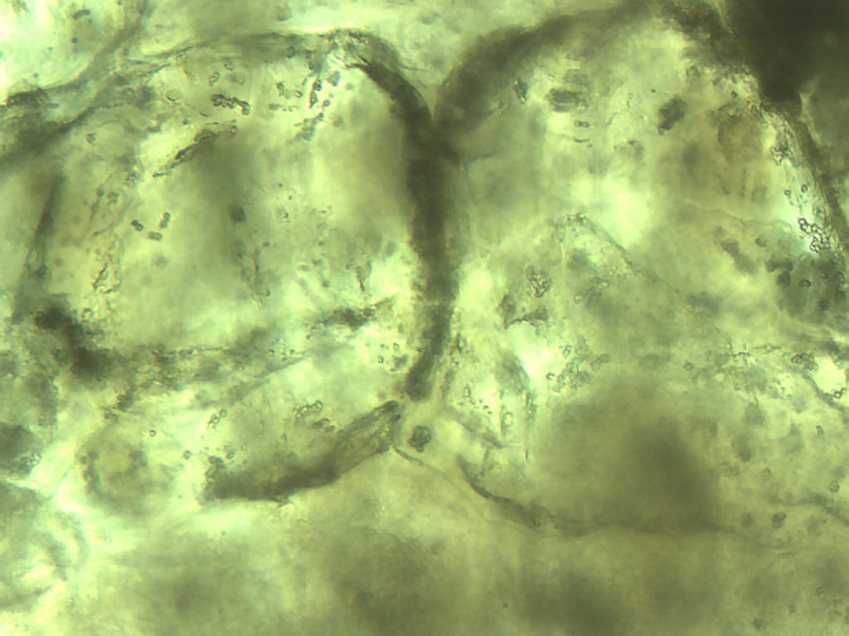
Notes:
234. Grape, green. Parenchymal cells, 25X.

Slide 14
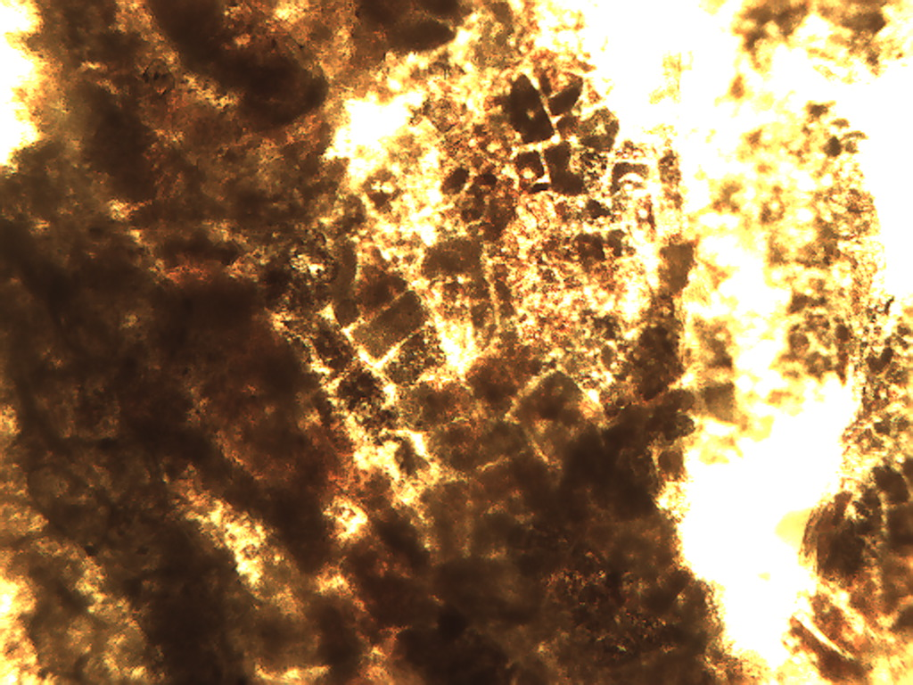
Notes:
235. Vitus spp. L. Grape, red. Skin, 4X.

Slide 15
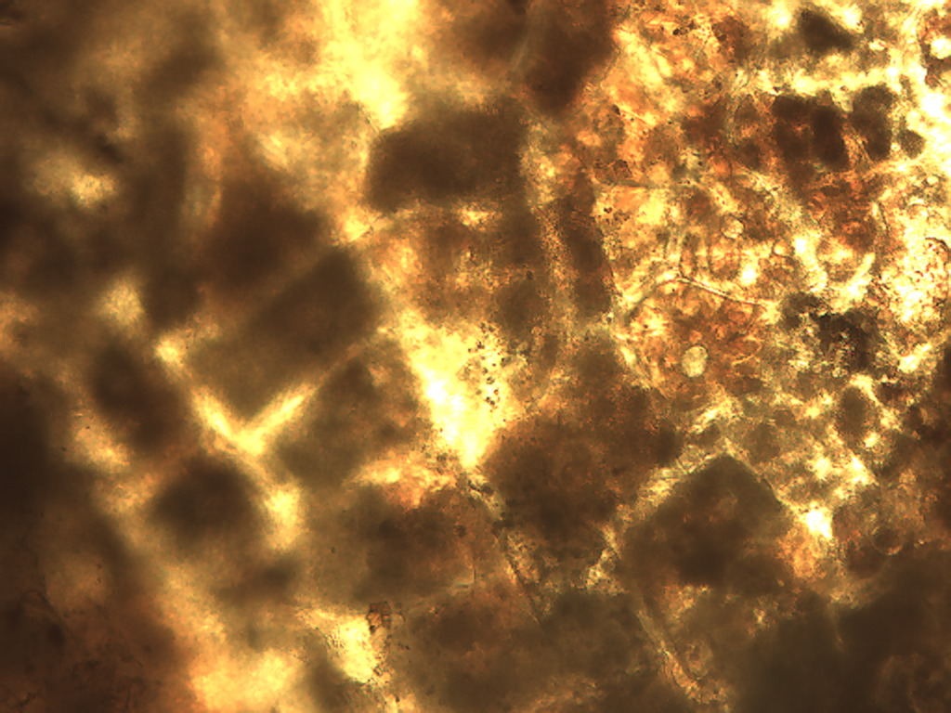
Notes:
236. Grape, red. Skin, 10X.

Slide 16
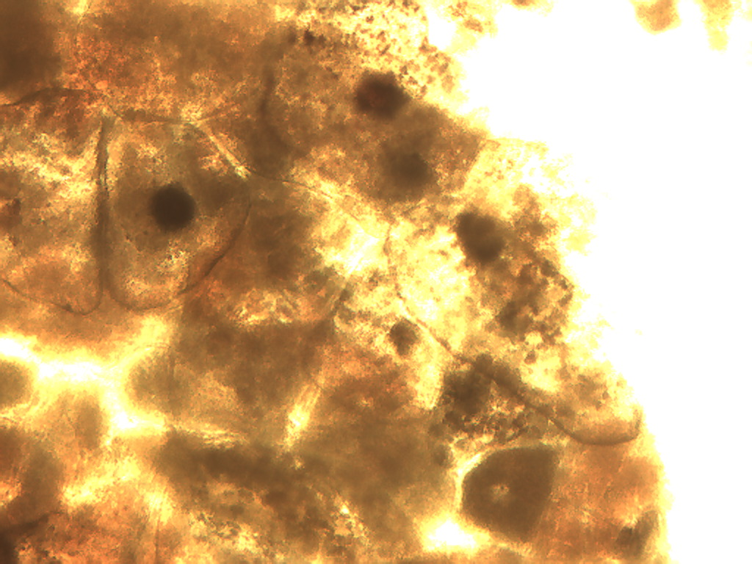
Notes:
237. Grape, red. Skin, 10X. No filter.

Slide 17
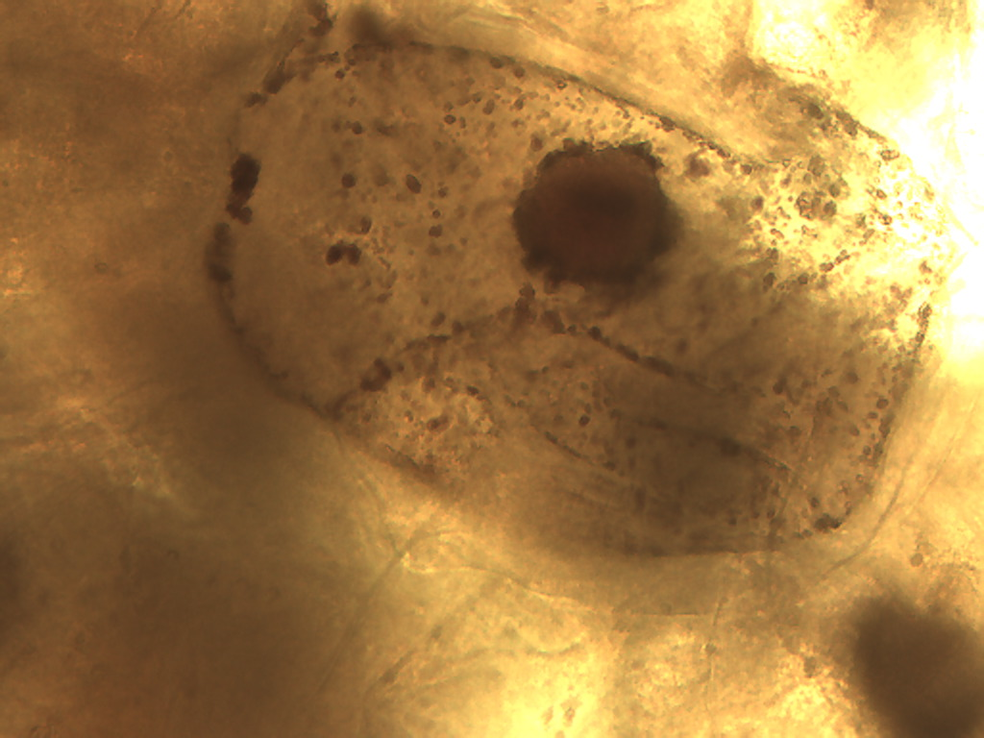
Notes:
238. Grape, red. Skin, 25X. No filter.

Slide 18
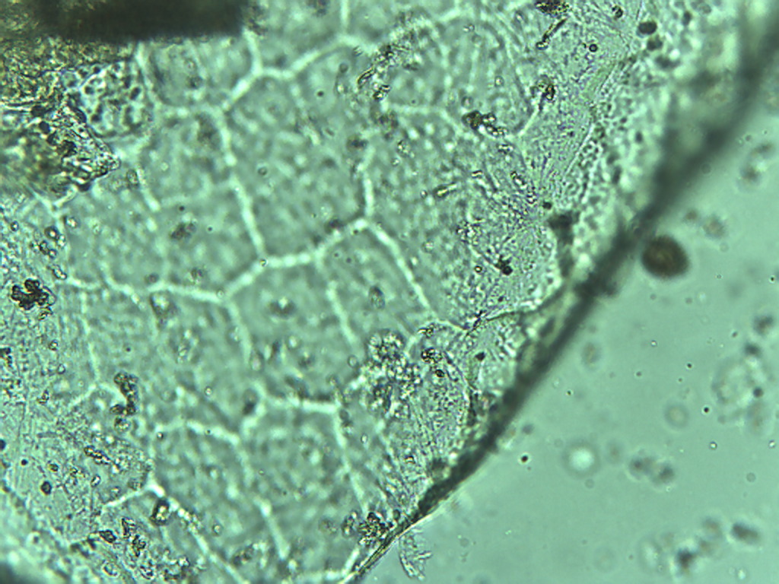
Notes:
239. Grape, red. Skin epidermis, 25X.

Slide 19
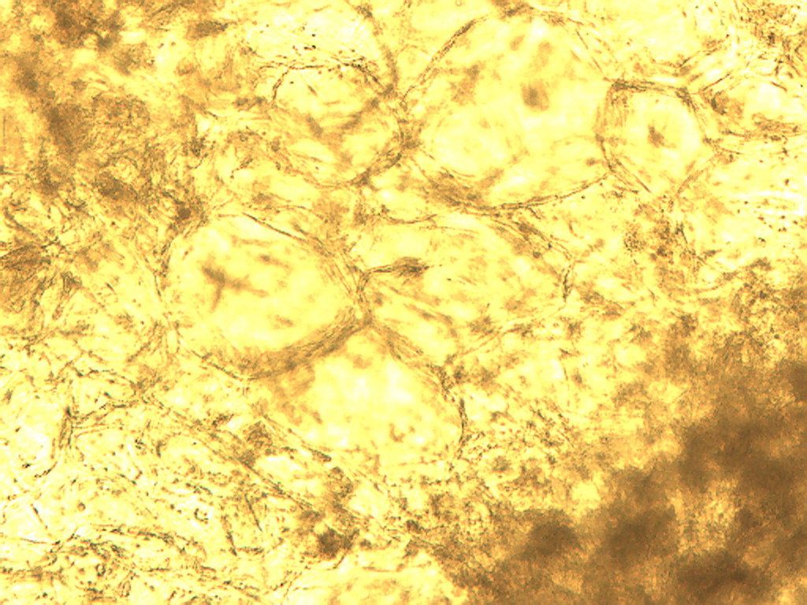
Notes:
240. Grape, red. Pulp cells, 10X. No filter.

Slide 20
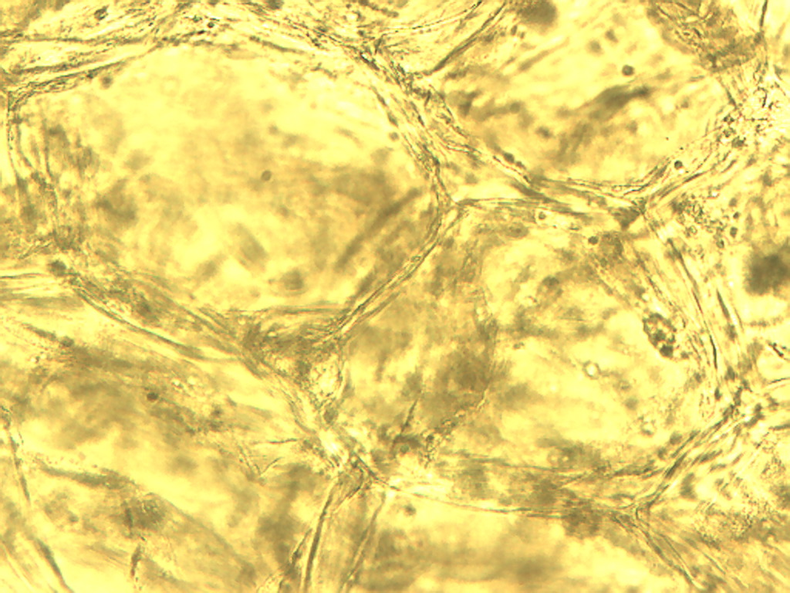
Notes:
241. Grape, red. Pulp parenchymal cells, 25X. No filter.

